Slide 1
RESUME REVIEW

Slide 2
Resume sections
Contact information
Summary Statement
Education & Training
Experience
Qualifications
Skills
Optional sections (Military Section)

Slide 3
Types of resume
Chronological
Functional
Combination
Targeted
Infographic resume – graphic design elements
Mini resume – business cards
Federal resume
Curriculum vitae – for doctors, lawyers, jobs in academia, nurse, and other professional level jobs

Slide 4
Suggested style of fonts in your resume
Arial
Calibri
cambria
Helvetica
Garamond
Georgia
Times new roman
Century gothic
Gill sans MT
Lucida sans
Tahoma
Verdana
Trebuchet ms

Slide 5
Common mistakes
Typos and grammatical errors
Lacking specifics
One-size-fits-all approach
Highlighting duties instead of accomplishments
Going on too long or cutting too short
Bad summary
No action verbs
Visually too busy
Incorrect contact information

Slide 6
Power verbs handout

Slide 7
Give me 5
Game Rules:
Write 5 words related to the picture
Raise your hand if you have 5 words
The first team to raise hand must provide 5 words
If less than 5 words, no points will be awarded
Your team gets 5 points and some candy if you answered correctly

Slide 8
Name at least 5 sections of a resume.

Slide 9
Name at least 5 types of resume.

Slide 10
Name at least 5 powerful verbs that will make your resume awesome.

Slide 11
Name at least 5 common font styles used in a resume .

Slide 12
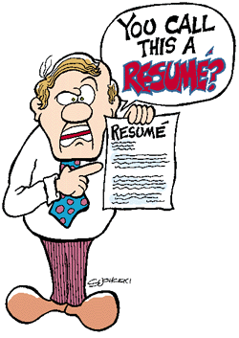
Name at least 5 common resume mistakes.

Slide 13
Resume critique

